Slide 1
C# in Games
The weird and interesting uses of .NET in game development

Slide 2



👋 Andreia “shana” Gaita
Editor Tools team lead @ GitHub
Mono hacker
Unity developer
sh4na (not a typo)
shana

Slide 3
Talking about scripting

Slide 4
What is a game?

Slide 5
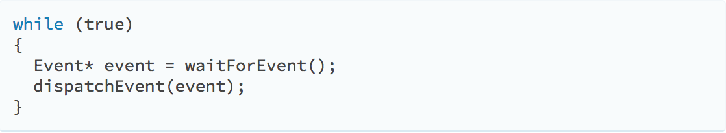
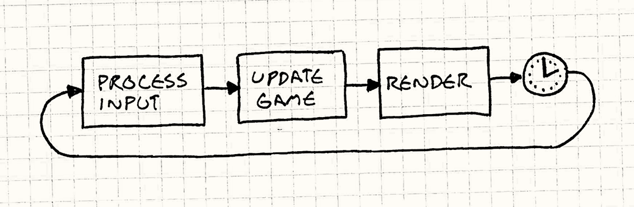
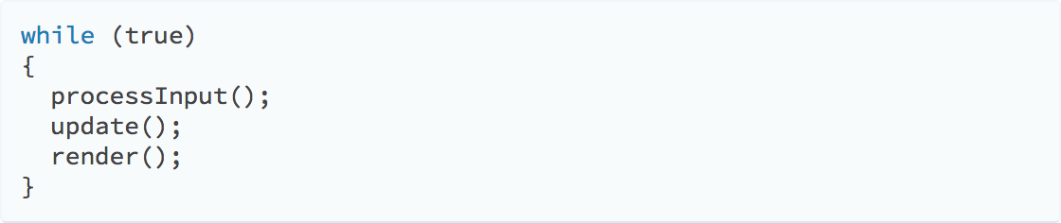
Application UI Loop
Game loop
Notes:
It's a simulation

Slide 6
performance
ugh pointers
Game engines
in C/C++
latency
FPS
Notes:
Game engines are often built in C/C++. Why?
Think back to the game loop
At 60 FPS, a single loop completes in 16ms. At 90, 11.11ms.
In VR, if you don't hit at least 60FPS consistently, you'll make people sick.
In VR, time between input and firing LCD photons > 20ms ==
C++ is a terrible language for expressing game logic
One word: pointers

Slide 7
sound
active story
interactions
but game content is
mechanics
writing
Notes:
Multi-disciplinary game teams all creating content
Designers, artists, writers, composers…

Slide 8
Squaring the circle?

Slide 9
preventing crashes
designers create with code
code is data
saving game state
fast iteration
Notes:
Separating the designer from the engine details
No need for designers to learn the engine’s language
Preventing crashes

Slide 10
data definition languages
Different types of language
runtime languages

Slide 11
transpiling
Runtime languages
compiling to native code
VMs
Notes:
Transpile into engine’s source language - generate C++
Doable, but doesn’t lend itself well to quick iteration and instant reloading
Compile into native code
Hard to port, have to roll your own compiler/debugger toolset
Compile to something that runs on a VM
Easy to reload at runtime
Existing tools
Enforces engine and data separation

Slide 12
The borders get blurred
Code is data
http://www.puzzlescript.net/

Slide 13
Experimentation is key
Fast iteration times
Constraints breed creativity
Performance is key
Notes:
Fast iteration times
Code is data, therefore languages are content creation tools
Experimentation is key
Trying out new ideas quickly while still able to scale to a finished game
Performance is key
Breeds new approaches to code design

Slide 14
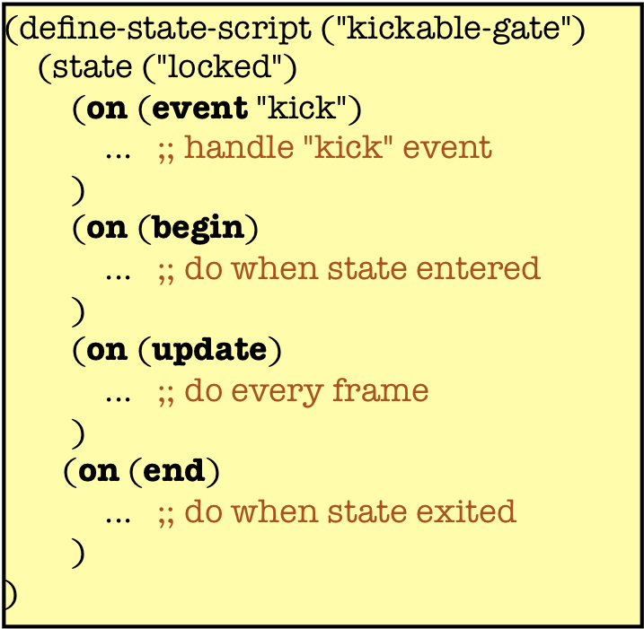
Example: Naughty Dog
Makers of Uncharted
Background in Lisp
Scheme-like language with lambdas and continuations
VM hosted by the engine
https://www.slideshare.net/naughty_dog/statebased-scripting-in-uncharted-2-among-thieves

Slide 15
Component based programming

Slide 16
Demo

Slide 17
Data driven design

Slide 18
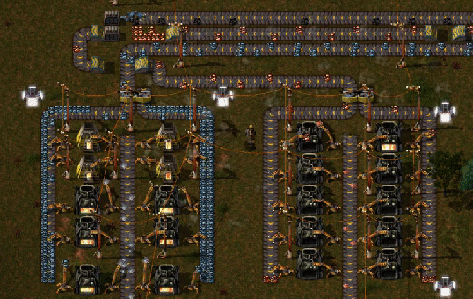

Slide 19
Demo

Slide 20
F#Kit
PuzzleScript
So much to explore...
Jonathan Blow
language series
Visual scripting

Slide 21
Thank you!
Questions anyone?
@sh4na
Andreia Gaita

Slide 22
Text
Text
Text
Text
Text
Text
Text

